Slide 1



A CRM Application on E-commerce
Activities
DOMAIN : Salesforce
TEAM ID : NM2023TMID01805
TEAM MEMBERS :
III YEAR / IT
SANJAI P (TEAM LEAD)
KANESHK P M
SRIRAM R
BOOPATHI S
Guided by:
Mr. R. AYYAPPAN, AP/IT
SPOC:
Mr. T. KARTHIKEYAN, AP/CSE

Slide 2
ABSTRACT
A Customer Relationship Management (CRM) application designed for E-Commerce activities to enhance customer interactions and streamline business processes.
The system aims to improve customer satisfaction and boost sales through effective data management and analytics.

Slide 3
EXISTING SYSTEM
Many E-Commerce businesses rely on manual data entry and separate tools for customer data, making it hard to maintain a holistic view of customer interactions.
Limited capacity to analyze customer data for personalized marketing and customer service.
Inefficient communication and collaboration among teams handling customer inquiries.

Slide 4

PROPOSED SOLUTION
A comprehensive CRM application that integrates with E-Commerce platforms, consolidating customer data into a single database.
Integration with analytics tools for data-driven decision-making.
Key features include:
Customer profile management
Order history tracking
Inventory and product management

Slide 5
FUNCTIONAL REQUIREMENTS
Customer Data Management | Data Capture Data Validation Data Privacy
Sales Lead Tracking | Lead Assignment Lead Progress Monitoring Lead Scoring
Customer Communication | Email Integration Automated Messaging Personalized Messaging
Reporting and Analytics | Sales Performance Analytics Customer Segmentation Predictive Analytics

Slide 6
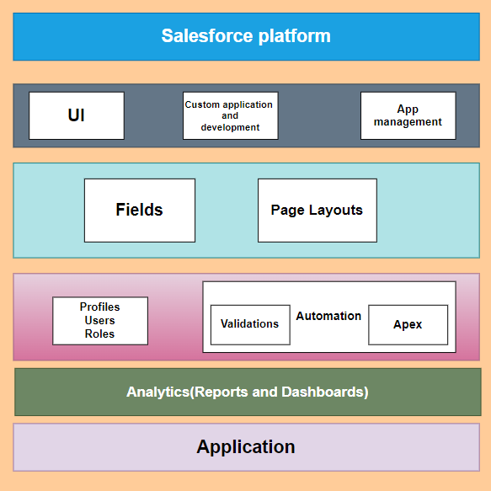
TECHNICAL ARCHITECTURE

Slide 7
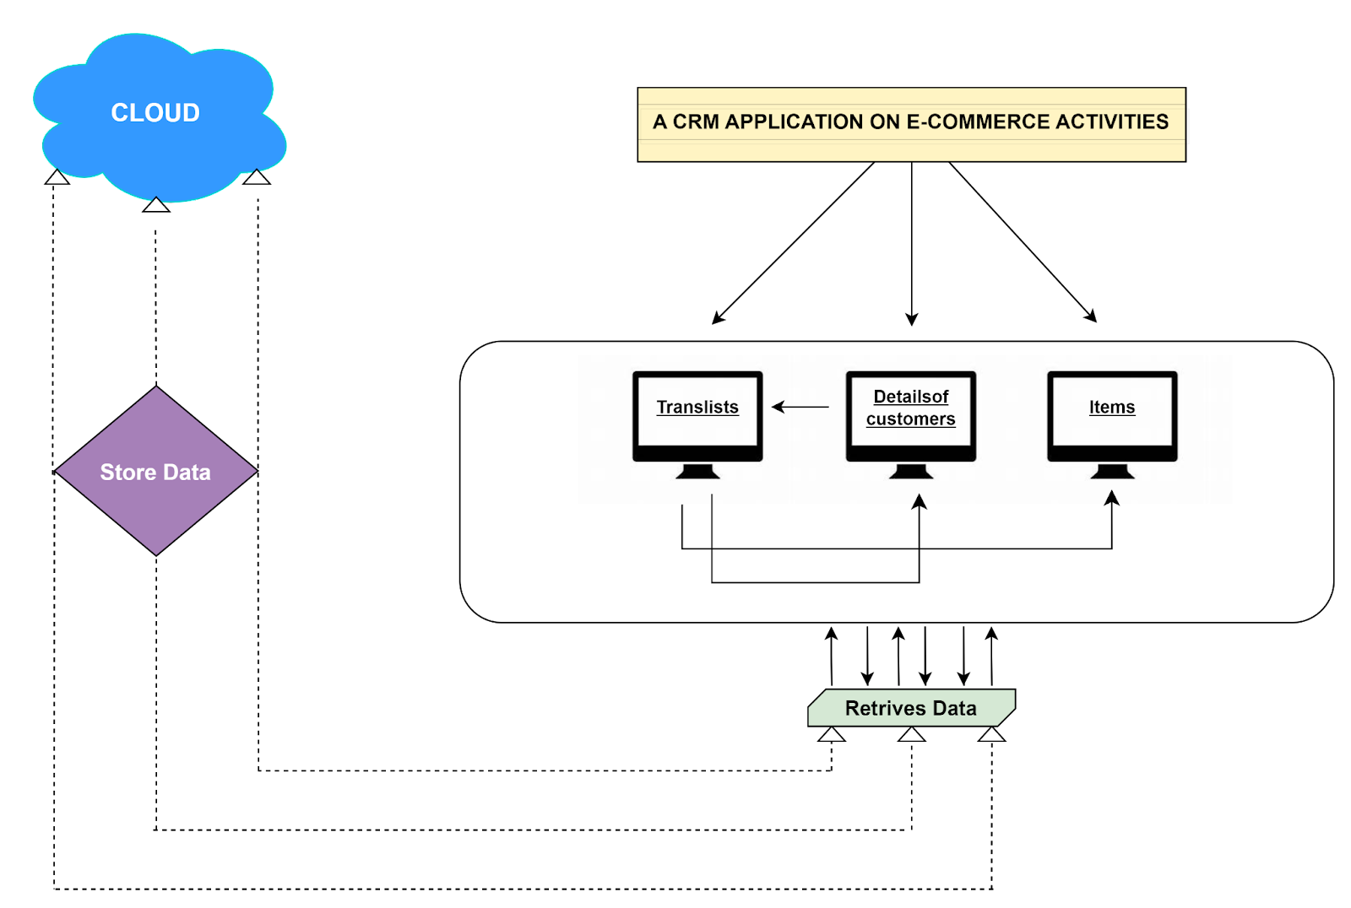
PROJECT FLOW DIAGRAM

Slide 8
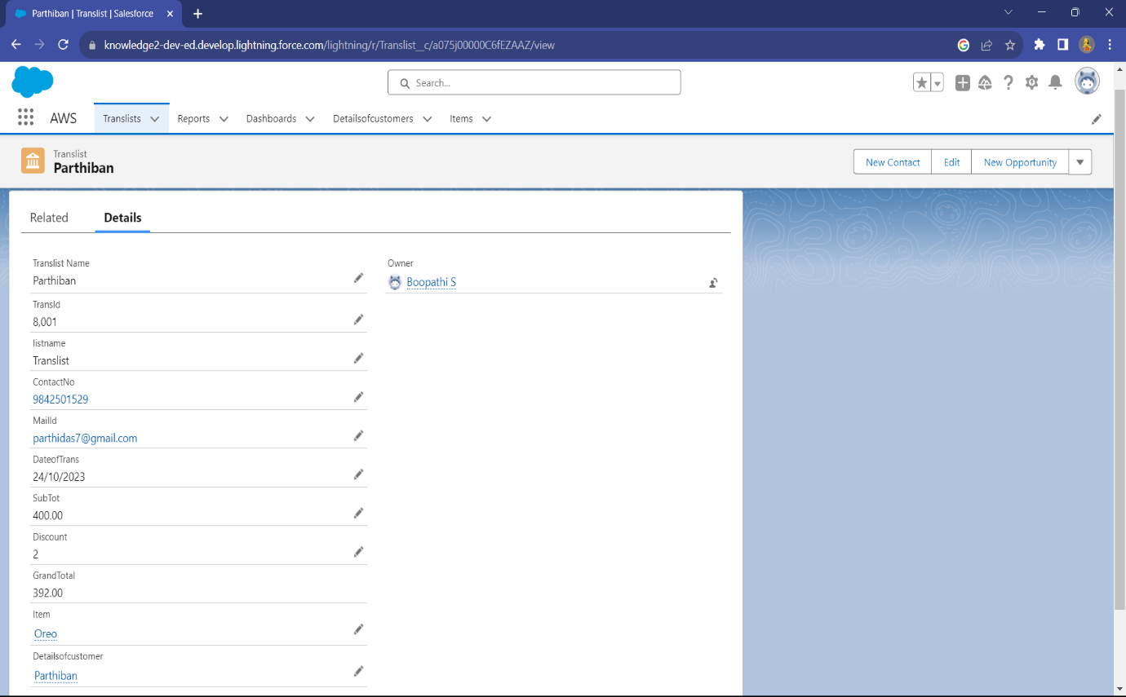
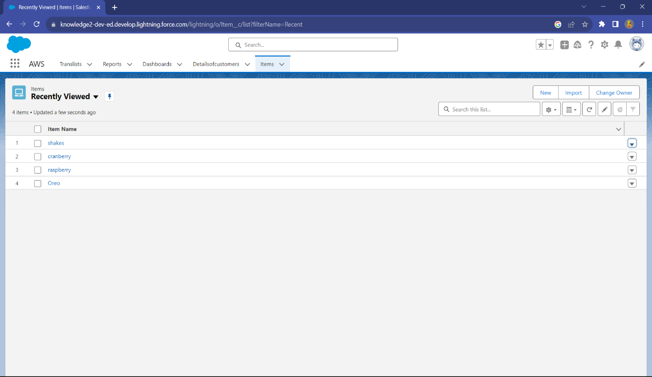
USER ADAPTION

Slide 9
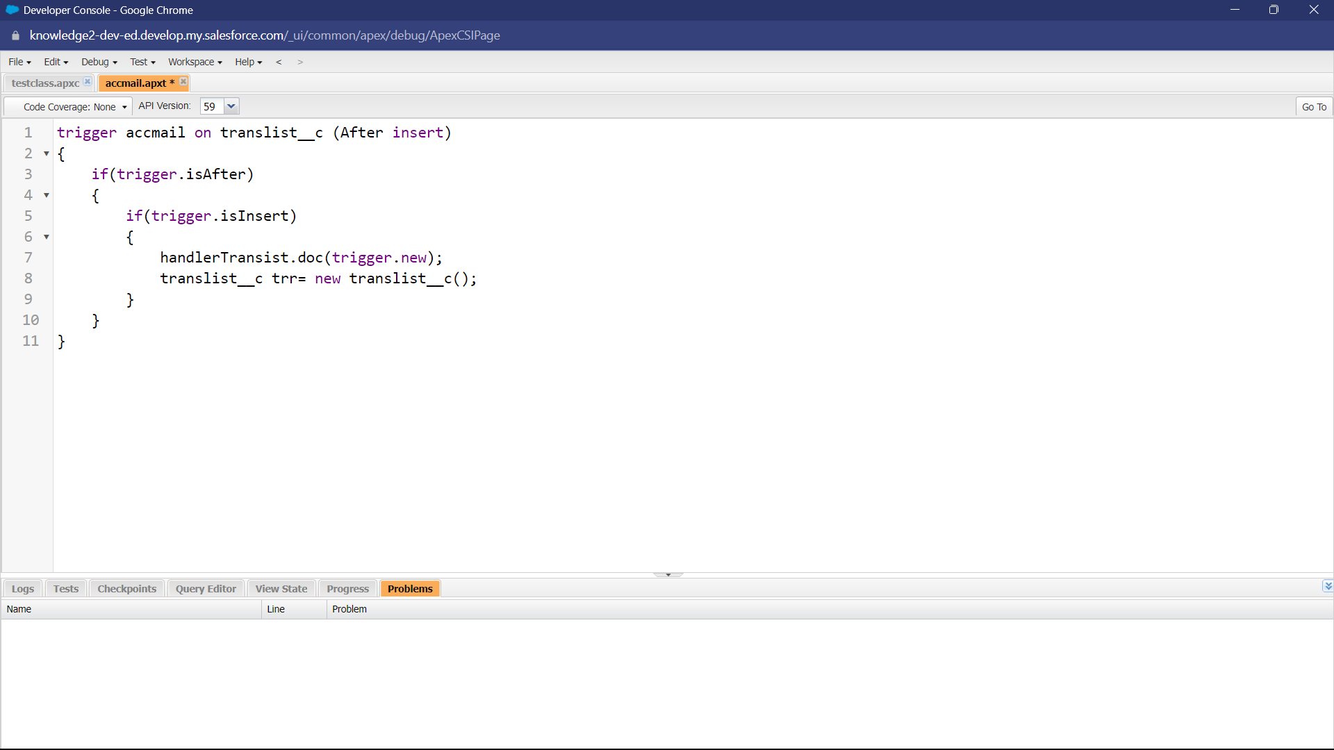
AUTOMATION
IDENTIFYING POTENTIAL CUTOMERS:
Trigger:

Slide 10
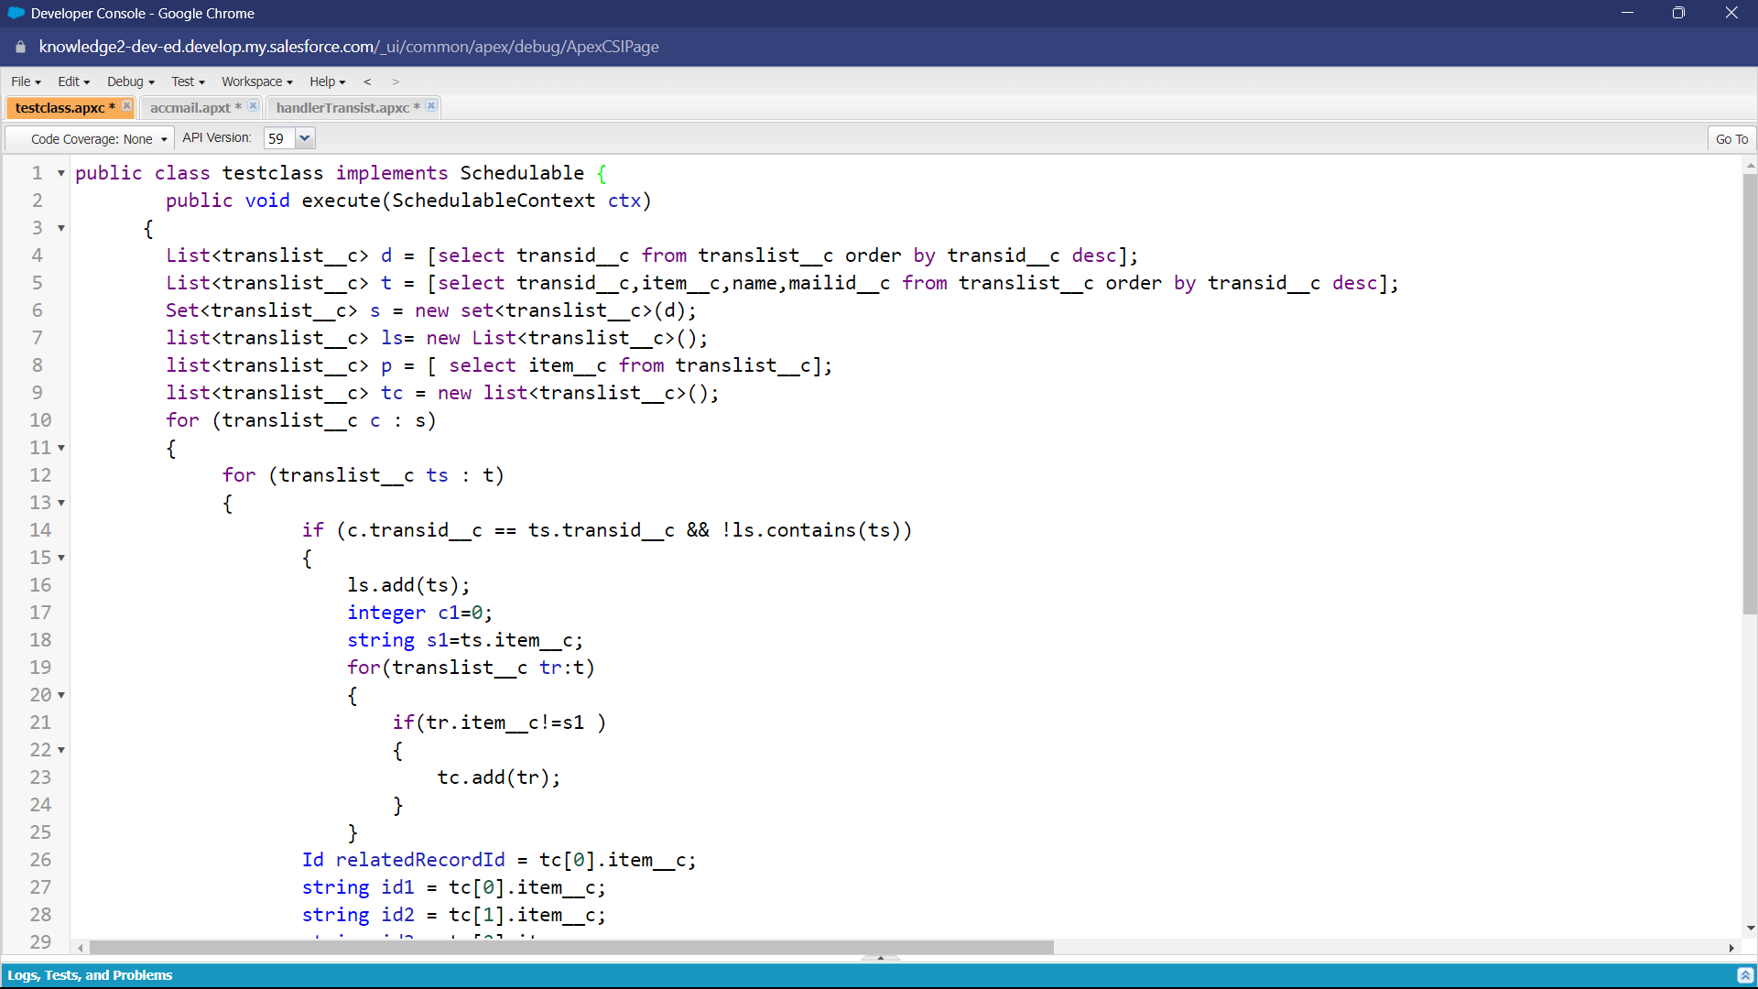
Apex Schedulers:

Slide 11
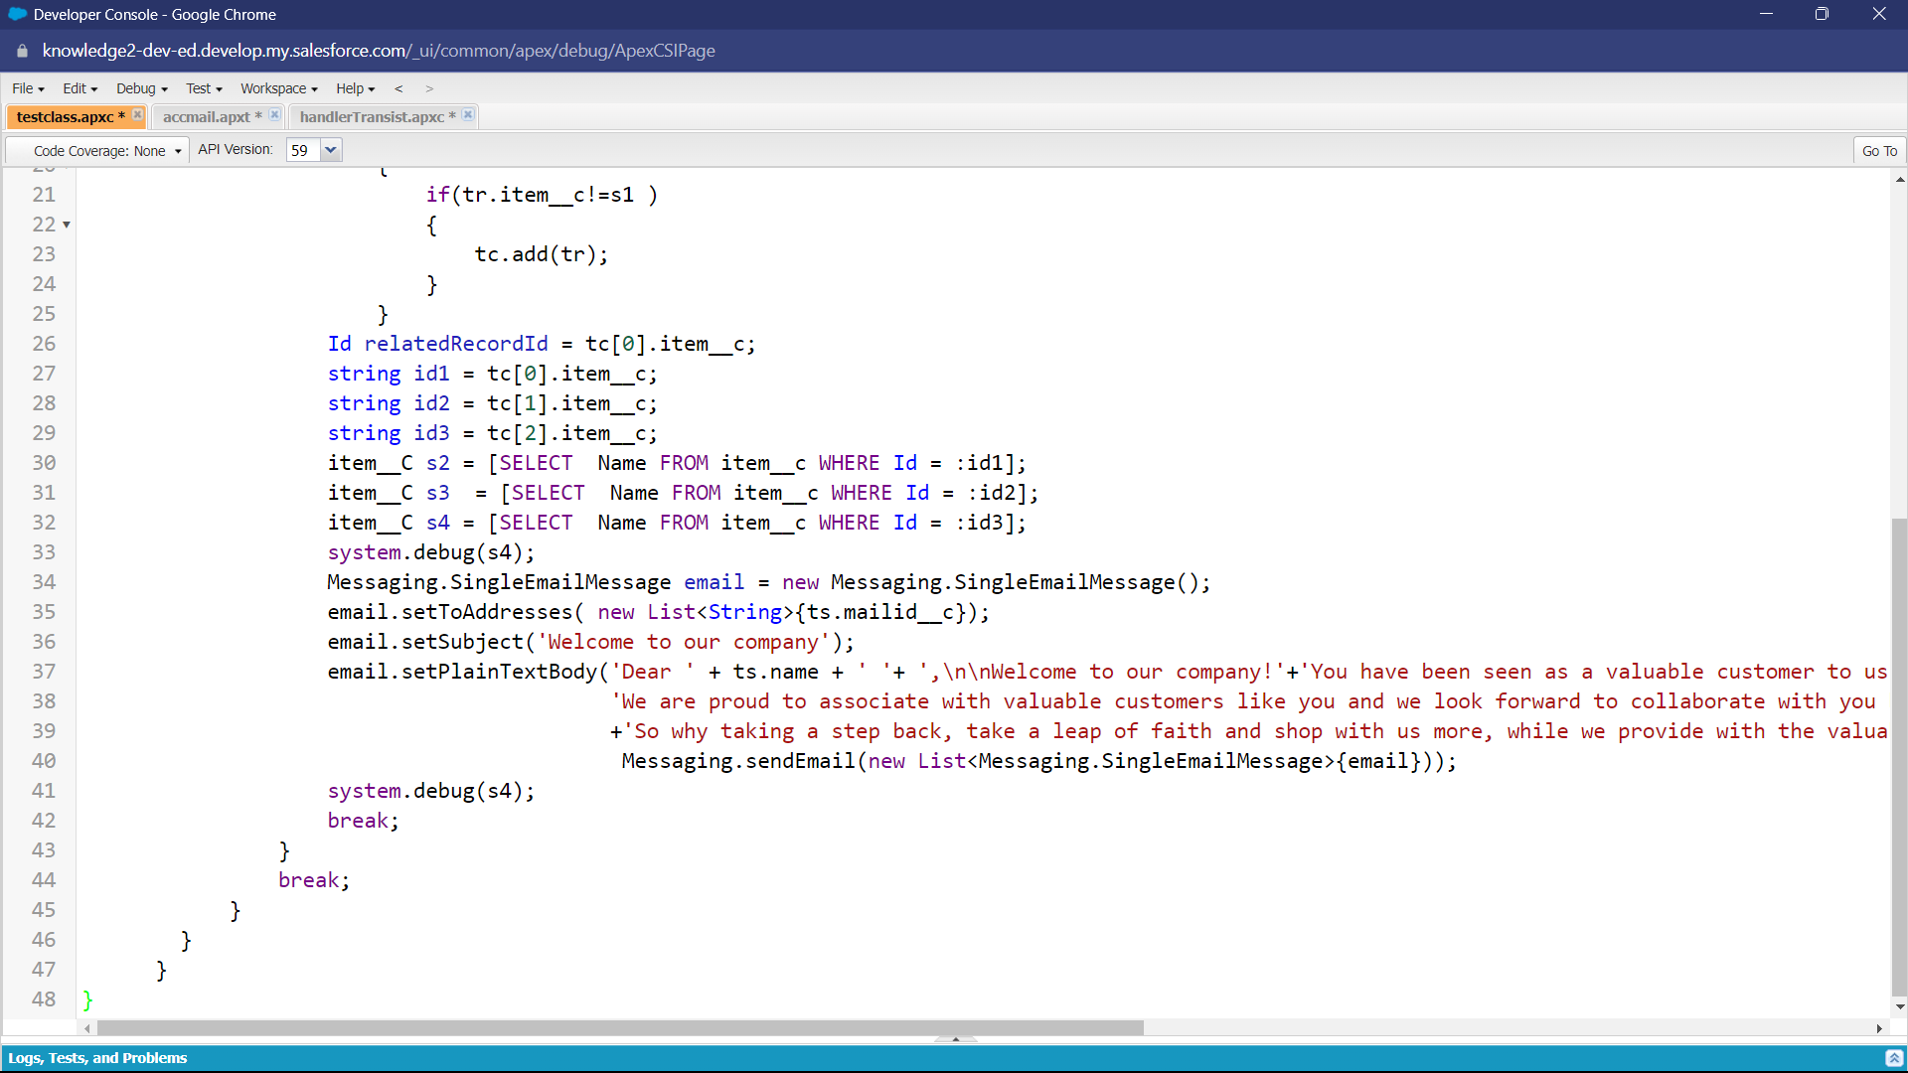

Slide 12
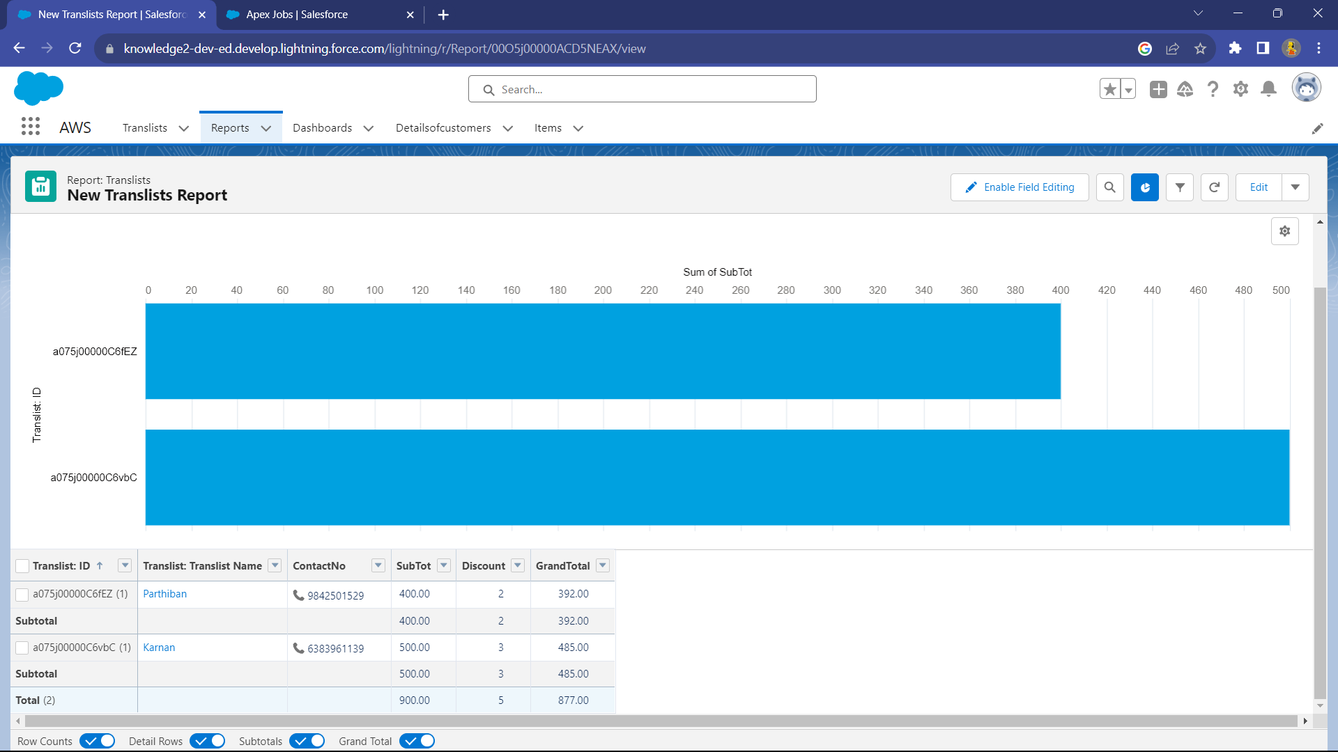
REPORTS & DASHBOARD
Report for Translists:

Slide 13
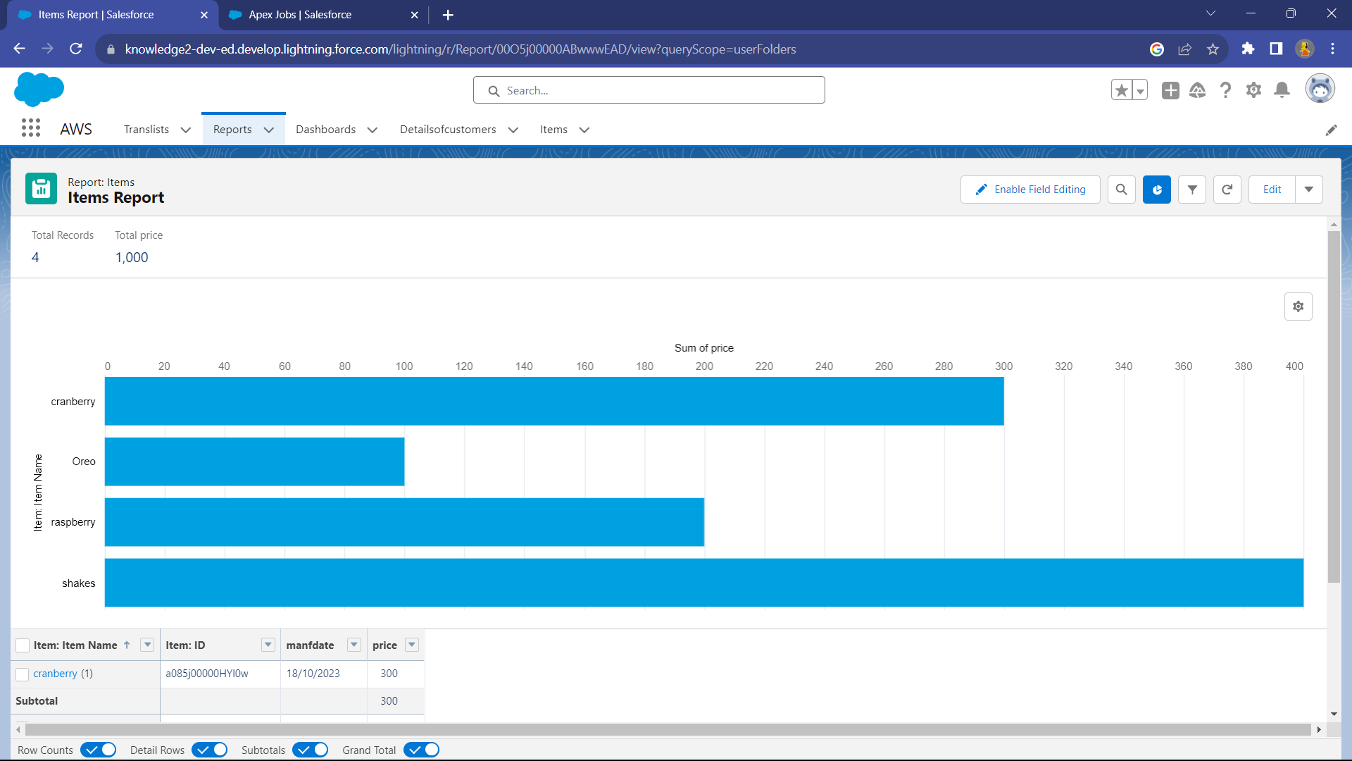
Report for Item:

Slide 14
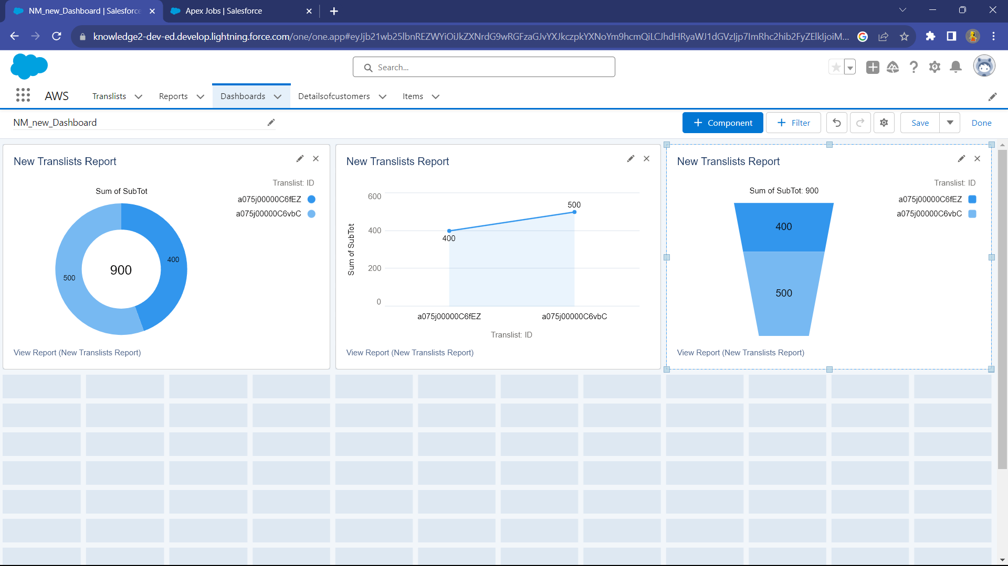
DASHBOARD

Slide 15
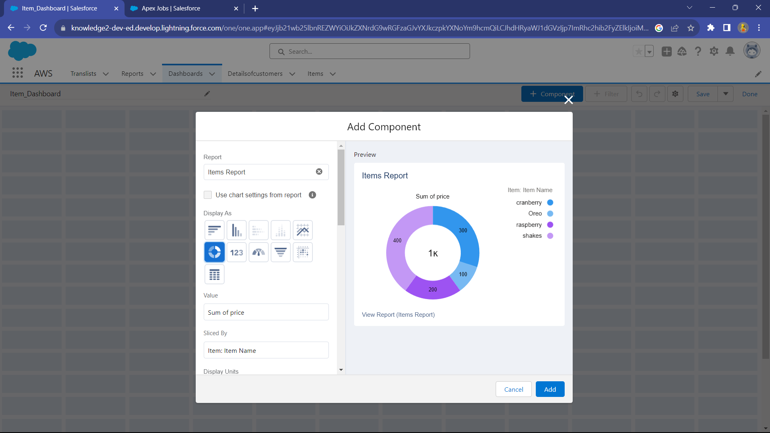

Slide 16
ADVANTAGES
Enhanced customer experience through personalized marketing and recommendations. Automated and duplicate evaluation.
Improved customer service and issue resolution with a unified ticketing system.
Better inventory management and demand forecasting.
Increased sales and customer retention.

Slide 17
CONCLUSION AND FUTURE SCOPE
The CRM application for E-Commerce activities delivers enhanced customer experiences, streamlined operations, and data-driven decision-making, leading to increased sales and customer retention.
Can incorporate IoT devices and data for enhanced customer insights, such as tracking product usage or providing proactive maintenance for connected products.
Enhance features for engaging with customers through online communities and social media platforms.

Slide 18
Thank you

